Slide 1
Stocko Sprint 2
Brendan Lucich, Alex Davis, Andrew Setka, Brady Mack
Source Code: https://github.com/Asetka/Stocko/tree/dev
Project Website: https://stocko.xyz
Jira: https://housing.atlassian.net/jira/software/projects/STOCKO/boards/2/backlog
ReadMe: https://github.com/Asetka/Stocko/tree/dev/sprint_deliverables

Slide 2
Stocko
Web app designed to provide casual investors with more information for long-term personal investments
Focused on an analytical process to investment in stocks
Use financial data about a company to provide evaluation metrics to determine the intrinsic value of the company

Slide 3
Backlog of Sprint 2 Goals
Story | Assignee(s) | Points
Deploy API To Hosting | Brady | 8
Link Add, Edit, and Delete to frontend | Brady, Alex | 5
Setup stock page on frontend | Andrew, Alex | 13
Create stock forecast Calculator | Brendan, Alex | 13
Allow for stock data to get passed through API call | Brendan | 3
Create additional documentation | Andrew | 8
Notes:
Jira
https://housing.atlassian.net/jira/software/projects/STOCKO/boards/2/backlog

Slide 4
Sprint 1 vs Sprint 2
In Sprint 2 we focused on doing the following better
Begin the sprint with clearly defined sprint goals and scope
Using similar amounts of time across the whole sprint
Working more closely with each other
Divided stories more evenly
More accurately assessed the workload of each task
Prepared for more bugs and errors during implementation

Slide 5
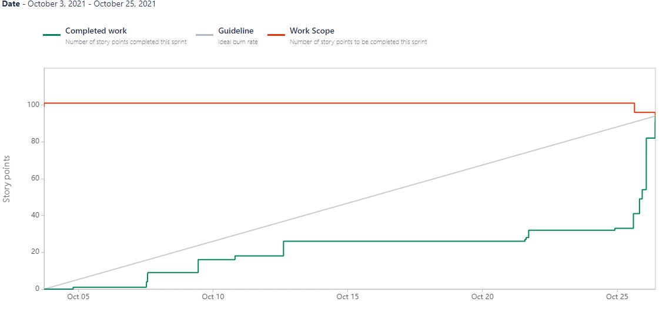
Burnup Chart (as of Sprint 2 Completion)

Slide 6
Sprint 2 Retrospective
Much better planning for scope of the sprint
Execution on the planning was still slightly lacking due to time management
UI has begin to come together and looks more professional
Need to add error checking to our positions
Initially think a bug may be caused by too many tickers or entering price as 0
Data formatting could be done easier to make it more universally applicable
Pair programming is cool and we should take better advantage of it
DON’T attempt to break things late into the sprint

Slide 7
Team Member Contributions
Brendan
Improved existing stock evaluation page
Implemented a stock price forecast calculator
Created the API response for the necessary data for the new stock page and chart view
Alex
Worked with Brady to add frontend support for adding, editing, and deleting positions
Worked with Andrew for stock page on the website
Redesigned some Sprint 1 features on the frontend
Andrew
Worked with Alex for stock page on the website
Worked with Brady for user management on our DB and auth0 user DB
Worked on project documentation
Brady
Deployed Flask API to Heroku
Worked to add frontend support for adding, editing, and deleting positions
Worked with Andrew to add new users with auth0 accounts to DB

Slide 8
Demo
Show added support for adding, editing, and deleting positions
Show newly added stock page
Show forecast price calculator
Show stock evaluation page

